Slide 1

COLLEGE TRANSPORT
MANAGEMENT SYSTEM
A Low-Code Application Development Project Using Zoho Creator
LIVYA REMI ROSI E • 240701289
Department of Computer Science and Engineering
Rajalakshmi Engineering College

Slide 2
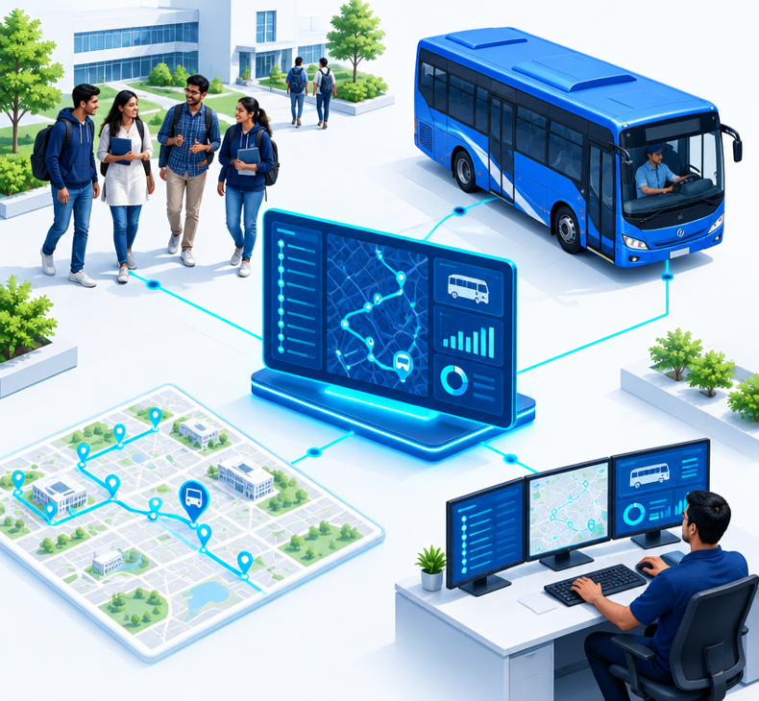
One platform. Every transport touchpoint.
A centralized digital platform for managing college transportation—from enrolment and routes to incidents, documents and reporting.
Student registration
Bus, driver, route & stop management
Fees & bus attendance
Complaints, emergencies & document alerts
Reports & dashboards

Slide 3
From scattered records to a connected system
CURRENT CHALLENGES
PROJECT OBJECTIVES
Manual records and scattered data
Digitize transport records
Time-consuming student registration
Simplify registration and data management
Limited visibility of bus capacity
Maintain bus, driver, route and fee information
Delayed communication and incident reporting
Improve reporting, communication and dashboards

Slide 4
Low-code foundation, connected end to end
PLATFORM Zoho Creator • Forms • Reports • Dashboards • Lookup fields • Deluge • Workflows
Users
Creator App
Forms
Database
Records
Workflows +
Deluge
Reports +
Dashboard
Subforms: configured / pending verification • Email delivery: pending verification

Slide 5
12 core forms shape the application
01
02
03
04
Student Details
Bus Details
Driver Details
Bus Route Assignment
Student information
Bus data & capacity
Driver information
Bus–route linkage
05
06
07
08
Transport Registration
Transport Fee Management
Bus Attendance
Complaint & Feedback
Student enrolment
Fees & payments
On-bus tracking
Issues & feedback
09
10
11
12
Emergency & Incident
Bus Document Alerts
Driver Document Alerts
Route Capacity Report
Incident logging
Expiry tracking
Expiry tracking
Capacity overview

Slide 6
Relationships organize the data—not duplicate it
Bus Details
Student
Details
Transport
Registration
Route Assignment
SUBFORMS
Driver Details
Useful for route stops or related entries inside a parent form. Treat as a pending design feature unless implementation is confirmed.

Slide 7
Automation with Deluge scripting
Auto-populate fields
Validate registration inputs
Fetch and update related records
Calculate transport fees
Run workflow actions
Trigger email notifications
// Illustrative example — not verified
if(input.Payment_Status == "Paid")
{
input.Balance_Amount = 0;
}
Logic shown for explanation only. Final field names, execution and outputs require verification.

Slide 8
Two workflows, with clear verification boundaries
TRANSPORT REGISTRATION
Form event
Process registration
Update related data
HIGH-PRIORITY INCIDENT ALERT
Incident submitted
Severity check
Conditional email
Transport Manager
Workflow execution and email delivery require testing. Email delivery is pending verification.

Slide 9
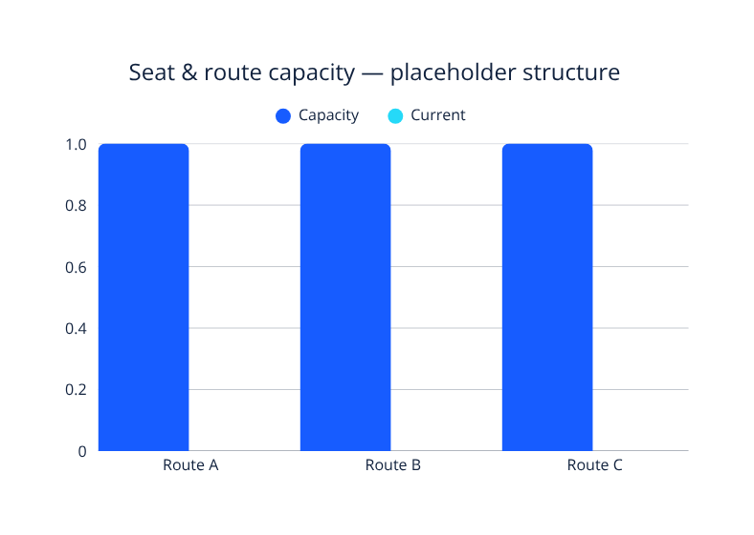
Reports turn records into operational visibility
REPORT COVERAGE
Student, bus & driver details
Registration & fee reports
Bus attendance
Complaints & feedback
Emergency & incidents
Bus and driver document alerts
Route capacity
Total Students
—
Buses & Drivers
—
Registered Students
—
Fee Status
—
Pending Complaints
—
Emergency Incidents
—

Slide 10
Validation plan before final sign-off
TEST ITEM
VALIDATION FOCUS
STATUS NOTE
Student Details
Record creation
To verify
Bus Details
Data storage
To verify
Transport Registration
Student, bus & route accuracy
To verify
Fee Management
Payment & balance logic
To verify
Incident Report
Submission and workflow trigger
To verify
Email Notification
Delivery to recipient
Pending verification
Reports & Dashboard
Data correctness and accuracy
To verify

Slide 11
Value today. Verification next. Vision ahead.
BENEFITS
PENDING VERIFICATION
FUTURE ENHANCEMENTS
Centralized transport data
Reduced manual entry and errors
Organized student and bus information
Easier reporting and tracking
Workflow-based automation
Lookup relationships and validations
Subform implementation
Email notification delivery
Dashboard accuracy
GPS-based live tracking
Parent and student mobile access
QR-code bus attendance
Online fee payment
SMS and messaging alerts
Predictive analytics

Slide 12

THANK YOU
The system demonstrates how a low-code platform can provide a strong foundation for efficient college transport management—with clear scope for testing and future enhancement.
LIVYA REMI ROSI E • 240701289
Department of Computer Science and Engineering
Rajalakshmi Engineering College

